Slide 1
Software Testing

Slide 2
Verification and Validation
Verification and validation includes a wide- array of SQA activities: technical reviews, quality and configuration audits, performance monitoring, simulation, feasibility study, documentation review, database review, algorithm analysis, development testing, usability testing, qualification testing, acceptance testing, and installation testing.

Slide 3
Verification and Validation
Software testing is one element of a broader topic that is often referred to as verification and validation (V&V).
Verification refers to the set of tasks that ensure that software correctly implements a specific function.
Validation refers to a different set of tasks that ensure that the software that has been built is traceable to customer requirements.
-Verification: “Are we building the product right?”
-Validation: “Are we building the right product?”

Slide 4
Software testing process has two distinct goals:
To demonstrate to the developer and the customer that the software meets its requirements.
-For custom software, this means that there should be at least one test for every requirement in the user and system requirements documents.
-For generic software products, it means that there should be tests for all of the system features that will be incorporated in the product release.

Slide 5
Software testing process has two distinct goals:
To discover faults or defects in the software where the behavior of the software is incorrect, undesirable or does not conform to its specification.
-Defect testing is concerned with rooting out all kinds of undesirable system behavior, such as system crashes, unwanted interactions with other systems, incorrect computations and data corruption.

Slide 6
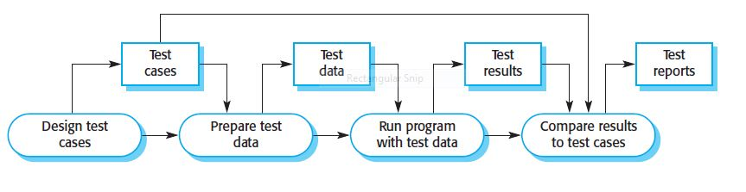
Model of the testing process

Slide 7
Test Case
Test case design is a part of system and component testing where you design the test cases (inputs and predicted outputs) that test the system.
The goal of the test case design process is to create a set of test cases that are effective in discovering program defects and showing that the system meets its requirements.
To design a test case, you select a feature of the system or component that you are testing.
You then select a set of inputs that execute that feature, document the expected outputs or output ranges.

Slide 8
Software Testing Strategy
The software process viewed as the spiral illustrated in the Figure.
Initially, system engineering defines the role of software and leads to software requirements analysis, where the information domain, function, behavior, performance, constraints, and validation criteria for software are established.
Moving inward along the spiral, you come to design and finally to coding.
To develop computer software, you spiral inward (counterclockwise).

Slide 9
Software Testing Strategy
A strategy for software testing may also be viewed in the context of the spiral.
Unit testing begins at the vortex of the spiral and concentrates on each unit (e.g., component, class, or WebApp content object) of the software as implemented in source code.
Testing progresses by moving outward along the spiral to integration testing, where the focus is on design and the construction of the software architecture.
Taking another turn outward on the spiral, you encounter validation testing, where requirements established as part of requirements modeling are validated against the software that has been constructed.
Finally, you arrive at system testing, where the software and other system elements are tested as a whole.
To test computer software, you spiral out in a clockwise direction.

Slide 10
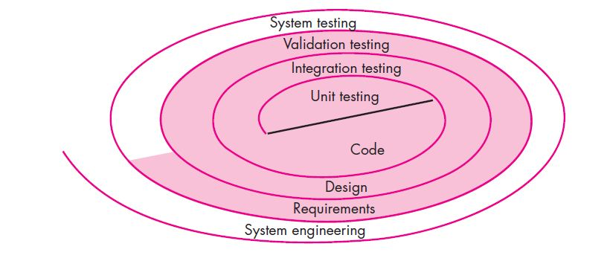
Testing strategy

Slide 11
Unit Testing
Unit testing focuses verification effort on the smallest unit of software design—the software component or module.
The unit test focuses on the internal processing logic and data structures within the boundaries of a component. This type of testing can be conducted in parallel for multiple components.
The module interface is tested to ensure that information properly flows into and out of the program unit under test.

Slide 12
Unit Testing
Local data structures are examined to ensure that data stored temporarily maintains its integrity during all steps in an algorithm’s execution.
All independent paths through the control structure are exercised to ensure that all statements in a module have been executed at least once.
Boundary conditions are tested to ensure that the module operates properly at boundaries established to limit or restrict processing.
And finally, all error-handling paths are tested.

Slide 13
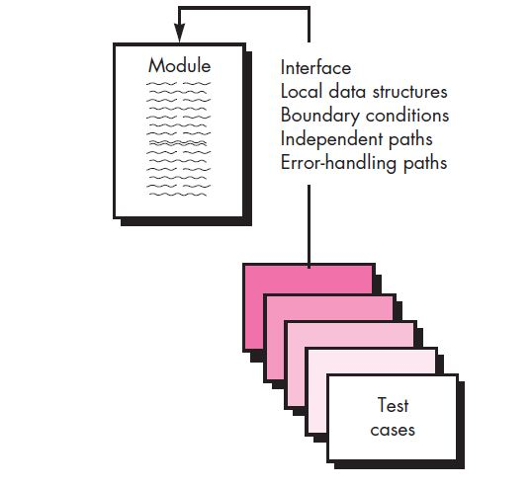
Unit Testing

Slide 14
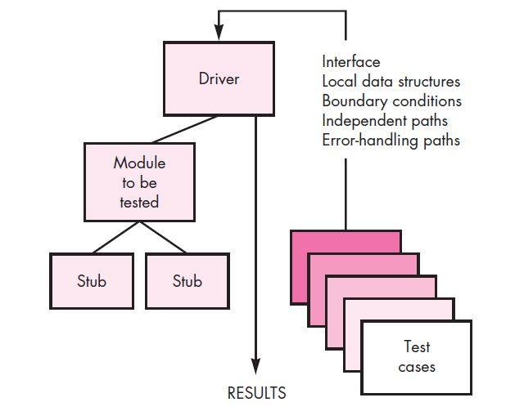
Unit-test environment

Slide 15
Unit-test environment
A driver is nothing more than a “main program” that accepts test case data, passes such data to the component (to be tested), and prints relevant results.
Stubs serve to replace modules that are subordinate (invoked by) the component to be tested. A stub or “dummy subprogram” uses the subordinate module’s interface, may do minimal data manipulation, prints verification of entry, and returns control to the module undergoing testing.

Slide 16
Integration Testing
Defined as a systematic technique for constructing the software architecture
At the same time integration is occurring, conduct tests to uncover errors associated with interfaces.
Objective is to take unit tested modules and build a program structure based on the prescribed design
Two Approaches
Non-incremental Integration Testing
Incremental Integration Testing

Slide 17
Non-incremental Integration Testing
Commonly called the “Big Bang” approach
All components are combined in advance
The entire program is tested as a whole
Chaos results
Many seemingly-unrelated errors are encountered
Correction is difficult because isolation of causes is complicated
Once a set of errors are corrected, more errors occur, and testing appears to enter an endless loop

Slide 18
Incremental Integration Testing
Three kinds
Top-down integration
Bottom-up integration
Sandwich integration
The program is constructed and tested in small increments
Errors are easier to isolate and correct
Interfaces are more likely to be tested completely
A systematic test approach is applied

Slide 19
Top-down Integration
Modules are integrated by moving downward through the control hierarchy, beginning with the main control module.
Modules subordinate to the main control module are incorporated into the structure in either a depth-first or breadth-first manner.
Depth-first integration integrates all components on a major control path of the program structure.
For example, selecting the left-hand path, components M1, M2 , M5 would be integrated first. Next, M8 or (if necessary for proper functioning of M2) M6 would be integrate.
Breadth-first integration incorporates all components directly subordinate at each level, moving across the structure horizontally.
From the figure, components M2, M3, and M4 would be integrated first. The next control level, M5, M6, and so on, followed.

Slide 20
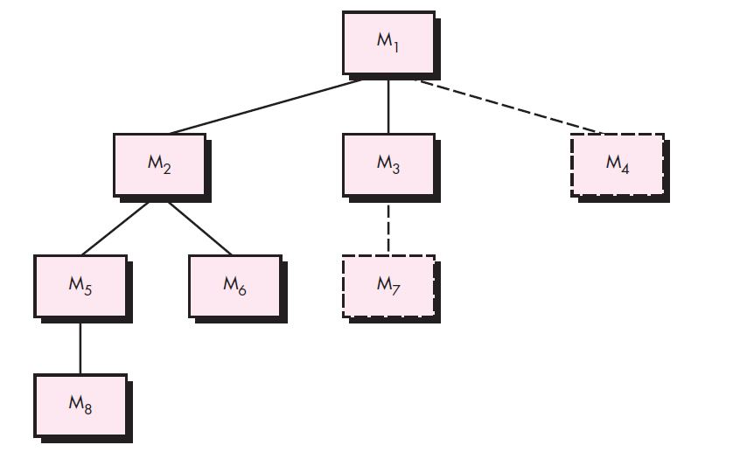
Top-down Integration

Slide 21
Bottom-up integration
Bottom-up integration testing, as its name implies, begins construction and testing with atomic modules
A bottom-up integration strategy may be implemented with the following steps:
1.Low-level components are combined into clusters (sometimes called builds) that perform a specific software sub-function.
2. A driver (a control program for testing) is written to coordinate test case input and output.
3. The cluster is tested.
4. Drivers are removed and clusters are combined moving upward in the program structure.

Slide 22
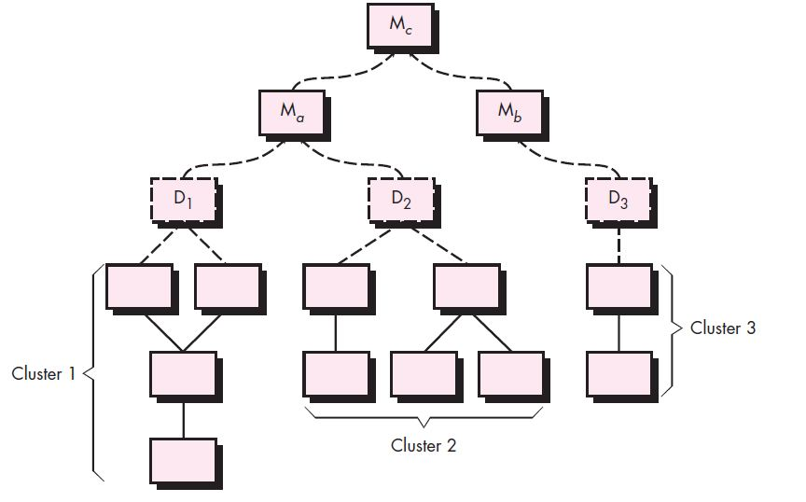
Bottom-up integration

Slide 23
Alpha and Beta Testing
Alpha testing
Conducted at the developer’s site by end users
Software is used in a natural setting with developers watching intently
Testing is conducted in a controlled environment
Beta testing
Conducted at end-user sites
Developer is generally not present
It serves as a live application of the software in an environment that cannot be controlled by the developer
The end-user records all problems that are encountered and reports these to the developers at regular intervals
After beta testing is complete, software engineers make software modifications and prepare for release of the software product to the entire customer base

Slide 24
System Testing
System testing is actually a series of different tests whose primary purpose is to fully exercise the computer-based system.
Although each test has a different purpose, all work to verify that system elements have been properly integrated and perform allocated functions.

Slide 25
Different Types of System Testing
Recovery testing:
Many computer-based systems must recover from faults and resume processing with little or no downtime and a system must be fault tolerant.
Recovery testing is a system test that forces the software to fail in a variety of ways and verifies that recovery is properly performed.
If recovery is automatic (performed by the system itself), re-initialization, check-pointing mechanisms, data recovery, and restart are evaluated for correctness.

Slide 26
Different Types of System Testing
Security testing
Verifies that protection mechanisms built into a system will, in fact, protect it from improper access.
Stress testing
Executes a system in a manner that demands resources in abnormal quantity, frequency, or volume.
Performance testing
Tests the run-time performance of software within the context of an integrated system.
Often coupled with stress testing and usually requires both hardware and software instrumentation.
Can uncover situations that lead to degradation and possible system failure.

Slide 27
Debugging Process
Debugging occurs as a consequence of successful testing
It is still very much an art rather than a science
Good debugging ability may be an innate human trait
Large variances in debugging ability exist
The debugging process begins with the execution of a test case
Results are assessed and the difference between expected and actual performance is encountered
This difference is a symptom of an underlying cause that lies hidden
The debugging process attempts to match symptom with cause, thereby leading to error correction

Slide 28
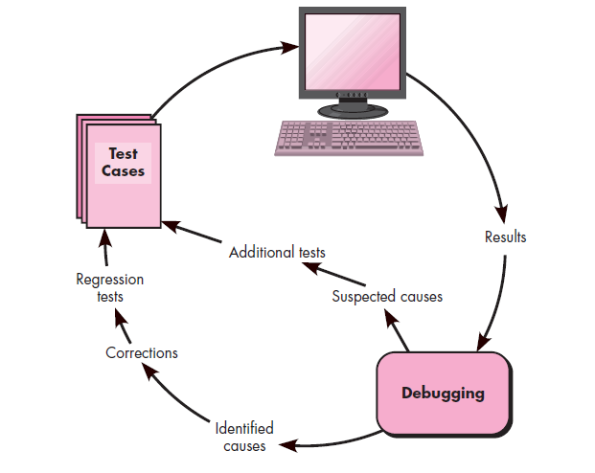
Debugging Process

Slide 29
Why is Debugging so Difficult?
The symptom and the cause may be geographically remote
The symptom may disappear (temporarily) when another error is corrected
The symptom may be caused by human error that is not easily traced
The symptom may be a result of timing problems, rather than processing problems

Slide 30
Debugging Strategies
There are three main debugging strategies
Brute force
Backtracking
Cause elimination

Slide 31
Brute Force
Most commonly used and least efficient method
Used when all else fails
Involves the use of memory dumps, run-time traces, and output statements
Leads many times to wasted effort and time

Slide 32
Backtracking
Can be used successfully in small programs
The method starts at the location where a symptom has been uncovered
The source code is then traced backward (manually) until the location of the cause is found
Unfortunately, as the number of source lines increases, the number of potential backward paths may become unmanageably large

